Slide 1
The Connection Between Land Pollution
Biodiversity Loss

Slide 2
Agenda
Team Details and Cuide Details
2 Agenda
Introduction ob)estive Literature Survey
Problem Statement
Use Case Diagram
Modules
Algorithms//vlethodotogy
Testin₉
Test Cases and Validation Testing
1y Pe/forma0Ce Analysis
Screerishots
Conclusion
Future Work
Graphical Representation of Land Pollution and Biodiversity Loss
References

Slide 3
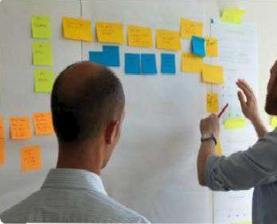
Agenda
Overview of Our Presentation Structure
Presentation Structure: A clear outline of the topics we VIII coyei, ensuring a logical flow of information throughout the presentation.
Key Toplca: We will delve Intothe definitions. objectives, literature survey, and proposed solutions regarding land pollution and biodiversity loss
Photo by Sebsstieñ Bonneval

Slide 4

Team Details and Guide Details
Introducing Our Team and Project Principles
T‹xrzi I\Members: A divarse group of experts iridudlng ecologists, éwironmental sclemsts, and'deta analysts, easti b‹JngIng unlque skills to the project.
Pf0je«t auldlng Principles: our project lv guided by principles of austainablllty, sclentific Integrity, and community engagement ensurlng that our fir›dInga are actlonable and rek›yant.
Photo by Ven Tay Medla

Slide 5


Introduction
Understanding Land Pollution and Biodiversity
Definition•f Land Pollution:Land pollution refers to the degradation of the Earth's land surfaces, often caused by human activities such as industrial waste disposal, agricultural practices, and urban development.
Importance of Blodiyers Biodiversity encompasses the variety of life on Earth, playing a critical role in ecosystem stability, reslllence, and the provision of ecosystem services.
Connection to Blodlveralty Loea: Land pollution disrupts habitats, contaminates soil and water, and poses direct threats to species survival, leading to significant blodlverslty loss.
Photo by JAKARIA AI hossain on I

Slide 6
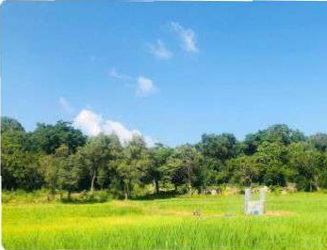
Objetive
Goals of Our Research
Impsct Anslyals: We alm to thoroughly analyze how land pollution affects various aspects of biodiverslty, including species diversity and ecosystem frthct1onallty.
ldeñttfyllfg Key Fa0tof8: Our research wlll Identify the primary contributors to biodiversity loss, Inc\udIng pollutants, habitat destruct\on, and chaste change.
Proposing 9oluBona: Wewlll propose act\arableao\ut\oneand strategies to mIt\gate the adverse effe’Cts of land poIIutio'ñ en biodiversity.

Slide 7

Literature Survey
Review of Relevant Research
Ralavaot Papars: A comprehensivetable featuring 10-15 significant studies that explore the relationship between land pollution and biodiversity.
Key Flndlngs: Each paper's contributions willbe summarized, highlighting their findlngs and relevance to our research objectives.
Research Oaps: We will identify gaps In existing literature that our research aims to address, paving the way for future studies.
Photo bv Ousa Chea

Slide 8
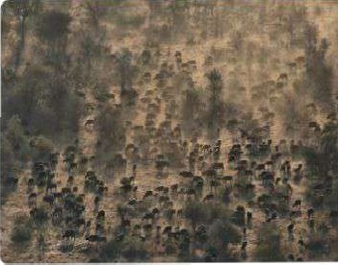
Problem Statement
Challenges Posed by Land Pollution
* SpeclflC IBSucs Land pollutlon leads to soil degradation, water contamlnation, and habitat destruction, poslng severe threats to wildlife and plant species.
Impact on Species: Various species, particularly those that are endangered or have specialized habitat requirements, are disproportionately affected by land pollution.
Urgent Action Needed: The escalating rates of land pollution necessitate Immediate action to protect biodiversity and restore affected ecosystems.
Photo Dy Wyna0d Uys ‹

Slide 9

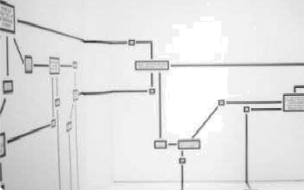
Use Case Diagram
Stakeholder Interactions
Stakeholder Inteta¢tlorls: The diagram Illustrates how different stakeholders, including researchers, policymakers, and community members, interact in the context of land pollutlon.
Sserierloa of I ripa¢t: Various scenarlos are deplcted to show the effects of land pollution on biodiversity and how stakeholders can respond.
Photo by Hanns Moms

Slide 10

Testing’
Ensuring Research ValidiŞ
s Testing Sttateglee: We will Implement a range of testing strategies to validate our findings, including cross-välidätlon and scrisltivlty ’analysis.
Yypas ofTeets: Different types’of tests will be conducted, such 8s statistical tests and model validation, to erlsMFe the reliabl'lity Of OUf fesUltG.
Tnola andTed›noIogIes: We will utlllze advanced tools Phd technologiefsor date an'aIysisąndtesting, ensuring rtgorous evaluation of our findings.
Phgte Dy NeúonalCancer Institute

Slide 11




Test Cases and Validation Testing
Ensuring Accuracy of Results
Specific Test Cases: we will develop speclfic test cases that align with our research objectives, ensurfng comprehensive validation of our findings.
Validation uufi•ds various veltdationmethods will be employed to assess the accuracyand reliability of our results, including peer review and expert consultation
Crlterla for 9uoness: Clear crltezla for success will be established to evaluate the effectlyeness of our research and Its contributionsto the field,
”” "
by Hans Reniers

Slide 12
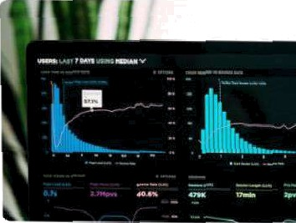
Performance Analysis
Evaluating Research Outcomes
Perfom ance Metrlss: We wlli utlllze a range of metrics to.evaluate the performance of our research, Including. accuracy, preclsldri. and recall.
Results of Analyala: The results wlll be analyzed to draw meaningful conclusions about the Imp’ac\ of land pollution on biodiversity.
i«tapestax o n»aings: We will Interpret our fundings In the context of existing literature, providlng Insights into the broader implications for blodlverslty Conservation.
Photo Dy Luke Cheeses

Slide 13
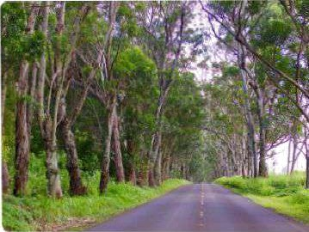
Future Work
Next Steps in Research
Suggestions for Further Research: We wlll outline potential areas for further research that can build upon gur findings and address remalnlng gaps.
Araas for Interventlon. Identlfylnp specific areas where Interventions can be Implemented to mitigate land pollution and enhance
biodiversity.
Long-term Goals: Our long term goals will focus on sustainable practices that promote biodtverslty preservation and ecosystem heatlh.
Photo by Leonardo Lunario

Slide 14
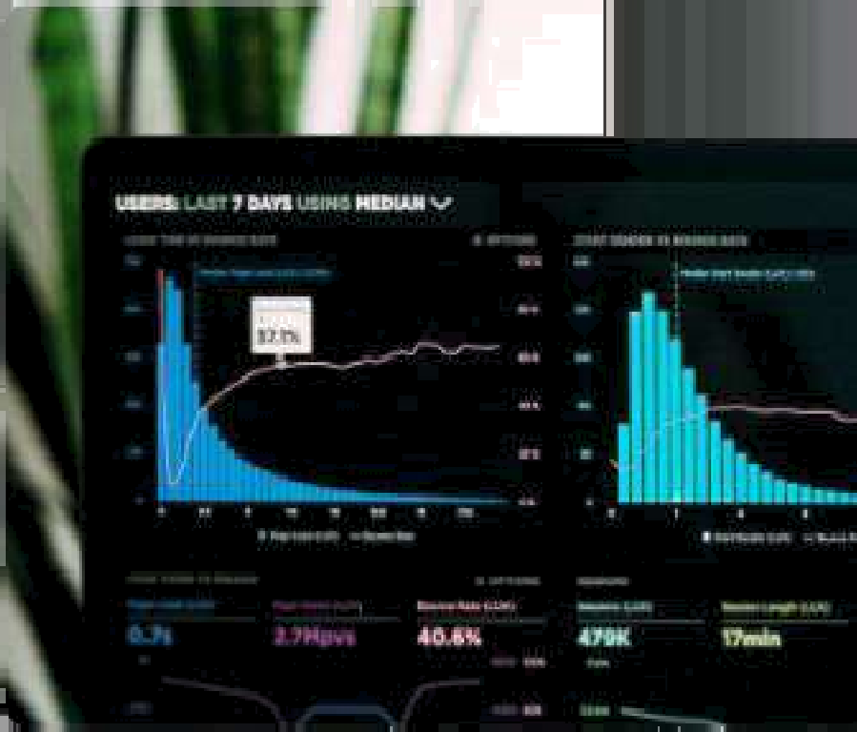



Graphical Representation of Land Pollution and Biodiversity
Visualizing the Impact
Correlagon Analysis: The grephicsl representstior showcases tic stetisticsT eletio ship between diffefent types of land pollutants and the corresponding dec1ine in biodiversity indices. This analysis highlights how'increased levels of pollutants such as heavy metals, pesticides, and plastics correlate with reduced species richness and abundance
lmpect Aeaeeslnent: Visual elernenis depict the specffc impacts elf land pollution on v'arious ecosysttems, illustrating how different pollutants affect lira and fauna. This esses4inent provides a clear understanding of which 4péciés
are most vdln0feble 8nd the eCo3yStem6 ‹hot aFg et reat0St.
» Policy fmpTlcsgone: The infographie.also inc1udes recommandations for policy intery9ntions based on the visual data. li emphasizes the need for tsrgeted regulet!ons and
¢OnSei›8tion effor‹S to iYiltigste the effeCt6 of land pollrltion On
biodiversité, g¿iding stakefiolders towardc actionable
solutfo’n’s.
Rota by Luxe C

Slide 15


References
Citations and Academic Standards
referencecsited throughout the presentation,
adherIng'to academlcstandards.
Fonuattlng 9tat›ds›ds: Referer›cea wlll be formatted according to establlzhed academtG cnatlon styles, ensurlng clarity and consistency.
Imporb›xeofIteferances:Each reference will be contertnallZ0d, h|ghIi@ting Its sl$nif›€BflGB In supporting our research findings and conc1USlOfk¡.

